Slide 1
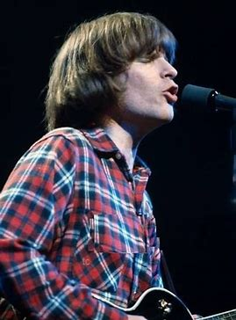
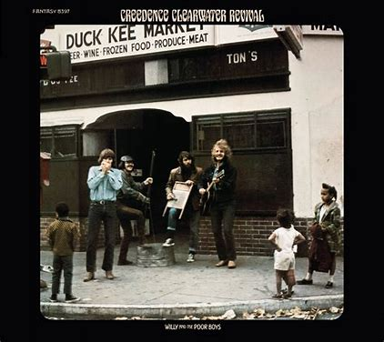
With some apologies to John Fogerty and Willy and the Poorboys

Slide 2
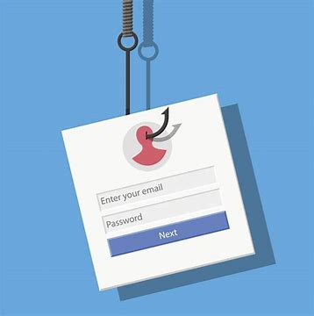
Spam in my inbox, that I ought to delete
They are phishing for my password
An’ sayin bitcoin can’t be beat

Slide 3
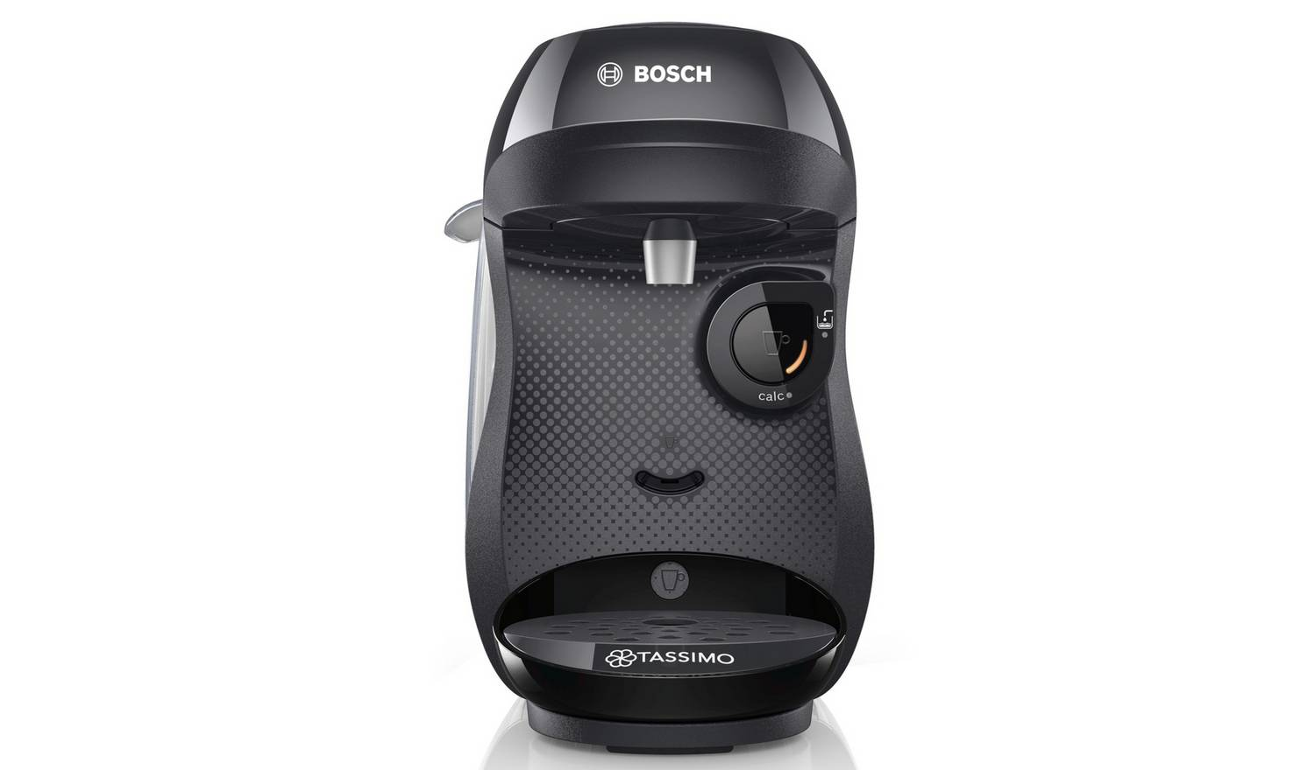
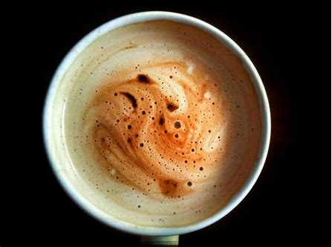
Early in the morning, just ‘bout coffee time
I’m over by the Tassimo, and starting to unwind
But someone’s stole my coffee cup, well that’s beyond the pail
Maybe I can find it, if I send y’all emails

Slide 4
Spam in my inbox, that I ought to delete
They are phishing for my password
An’ sayin bitcoin can’t be beat

Slide 5
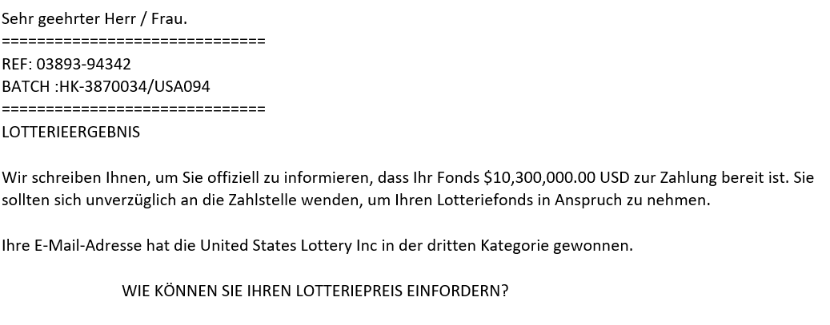
I’ve just been invited to a conference on the moon
They say I’m held in high esteem, it makes me want to swoon
And I can send my paper, if I pay a million bucks
I’m glad I won that lottery, you bet that I’m in luck

Slide 6
Spam in my inbox, that I ought to delete
offering a business connection
When my bank transfer’s complete

Slide 7
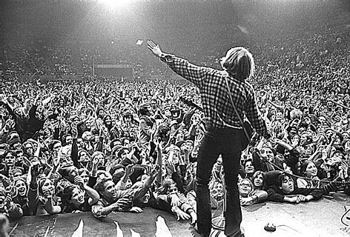
Very short instrumental break

Slide 8
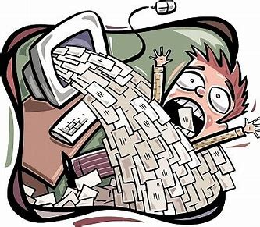
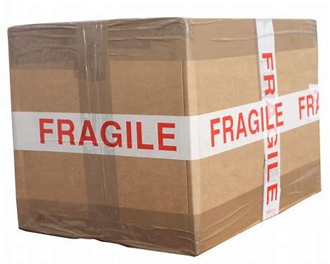
Hey, where is my parcel, you know it can’t be found
I’ll just email [met-all] and see if it’s around
And every single message will be sent to “reply-all”
Several hundred emails sent, if you could count ‘em all

Slide 9
Spam in my inbox, that I ought to delete
They are phishing for my password
An’ sayin bitcoin can’t be beat

Slide 10
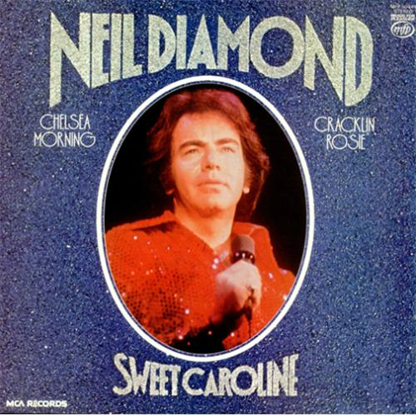
When NERC said “yes” to funding me, the email went to spam
I was told I must reply, oh what a fool I am
So much for that filter, it’s a waste of time
I’ll have to sing “these grants of mine” at next ye(a)rs pant’mime

Slide 11
Spam in my inbox, that I ought to delete
They are phishing for my password
An’ sayin bitcoin can’t be beat
Spam in my inbox, that I ought to delete
Promisin’ deep satisfaction,
In my own locality
Slowly to finish
Spam in my inbox, that I ought to delete

